Slide 1
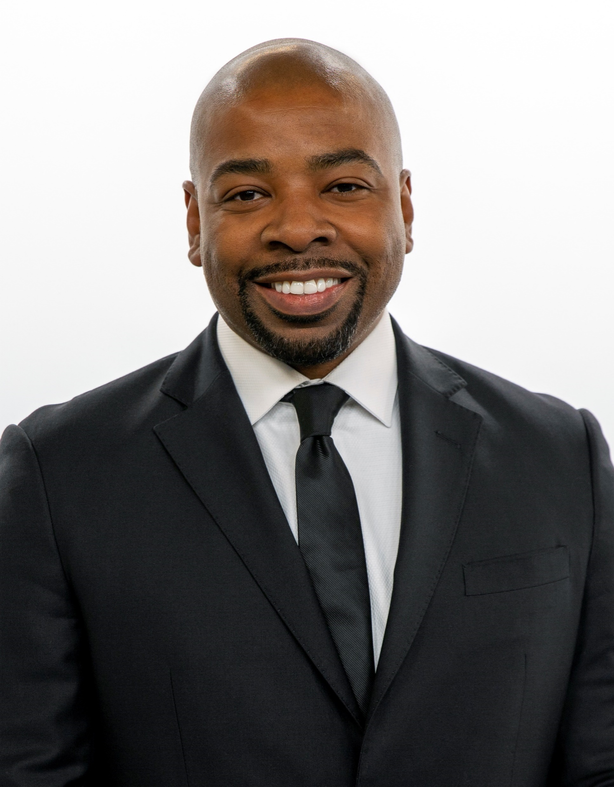
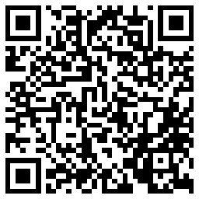
54th NCDA Annual Conference June 13-15, 2023 Orlando, FL
Management: Keeping Your Team Motivated
Darwin M. Wade, MBA, MPA, CPM
Assistant Director (I)
City of Dallas, Texas
Housing & Neighborhood Revitalization
Darwin.Wade@Dallas.gov
O: 214-670-3906 C: 469-404-6891

Slide 2
Let’s Define Motivation
What does motivation mean to you?
Motivation is the process of stimulating people’s action to accomplish goals. In other words, motivation involves stimulating desire and energy in people so that they show continuous interest and commitment to a job or to make an effort to a achieve a goal.
https://www.differencebetween.com/difference-between-motivation-and-morale/

Slide 3
Let’s Talk About It
Are you, the leader, motivated?
Why is motivation important to your team?
How do you know when your team is not motivated?
What are the signs?
How do you know when your team is motivated?
What are those signs?
Notes:
Median family income = $97,400
80% AMI for a family of four = $77,900
Population = 1,288,457
Poverty rate = 17.7%
Median household income = $58,231
% low mod = 52.8%

Slide 4
What is Our Role as Leaders
Engage with staff – My 4 Cs – Clear, Consistent and Constant Communication
Facilitate employee’s empowerment
What motivates them?
Extrinsic factors: External reward e.g., tangible, merit pay, bonus, plaques, avoid punishment
Intrinsic factors: e.g., sense of accomplishment, fulfillment, passionate, personal/professional development, collaboration
Develop your team
Demonstrate you care
Be unbiased and just
Reward and recognize
Reward and recognize openly
Reprimand privately

Slide 5
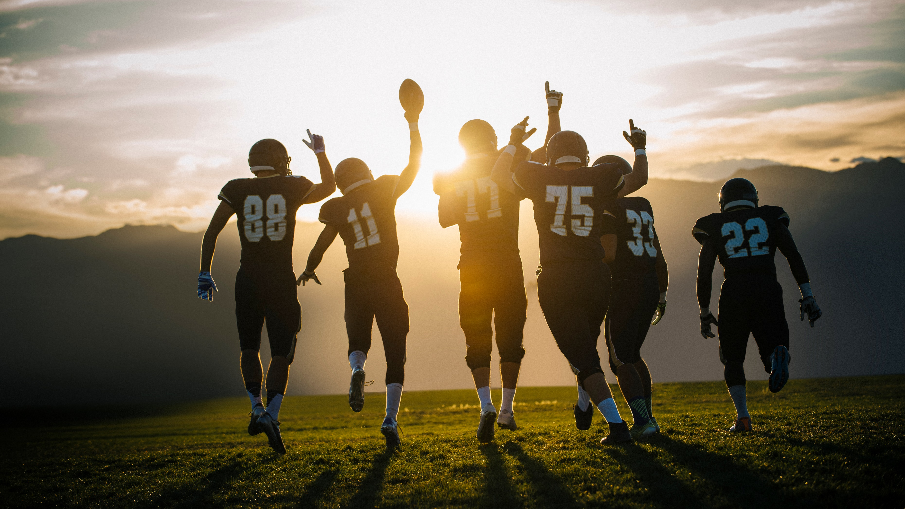
Takeaways on Motivating Your Team
Motivation will be different for each employee
Higher motivation leads to higher morale
Higher motivation leads to higher productivity
Listen emphatically
Encourage staff to take mental breaks and time off
Promote healthy wellbeing as a priority first
Increased flexibility on work schedules e.g., remote, hybrid
Recognition programs, breakfast, lunch, snacks, potlucks, treats, gift cards
Retreats, training, and teambuilding off-site

